Slide 1

Indranil Palit
Semantic and Execution-Aware Extract Method
Refactoring via Self-Supervised Learning and
Reinforcement Learning-Based Model Alignment
SMART Lab
Software Maintenance and Analytics Research Team
MCS Student
Faculty of Computer Science
Supervisor: Dr. Tushar Sharma
Notes:
Hello and good morning everyone. My name is Indranil Palit and I will be presenting my Master’s thesis titled …

Slide 2
outline
Introduction
Automatic refactoring candidate identification
Generating refactored code
Conclusions and Q&A
Notes:
Let’s go through a high-level overview of today’s talk. (click) I will first discuss the problem statement and limitations of existing work in the Introduction section, (click) continue with 2 proposed solutions, and discuss the experimental results. And finally, I will conclude the talk with some insights and open the floor for questions. (30s)

Slide 3
Introduction
Part 1
Notes:
Before I begin explaining our work on refactoring, let’s take a step back to understand why we refactor code. I will start by talking about code smells, how refactoring helps remove code smells and finally take an example of a popular code smell and extensively discuss how to use a specific refactoring to remove it.

Slide 4
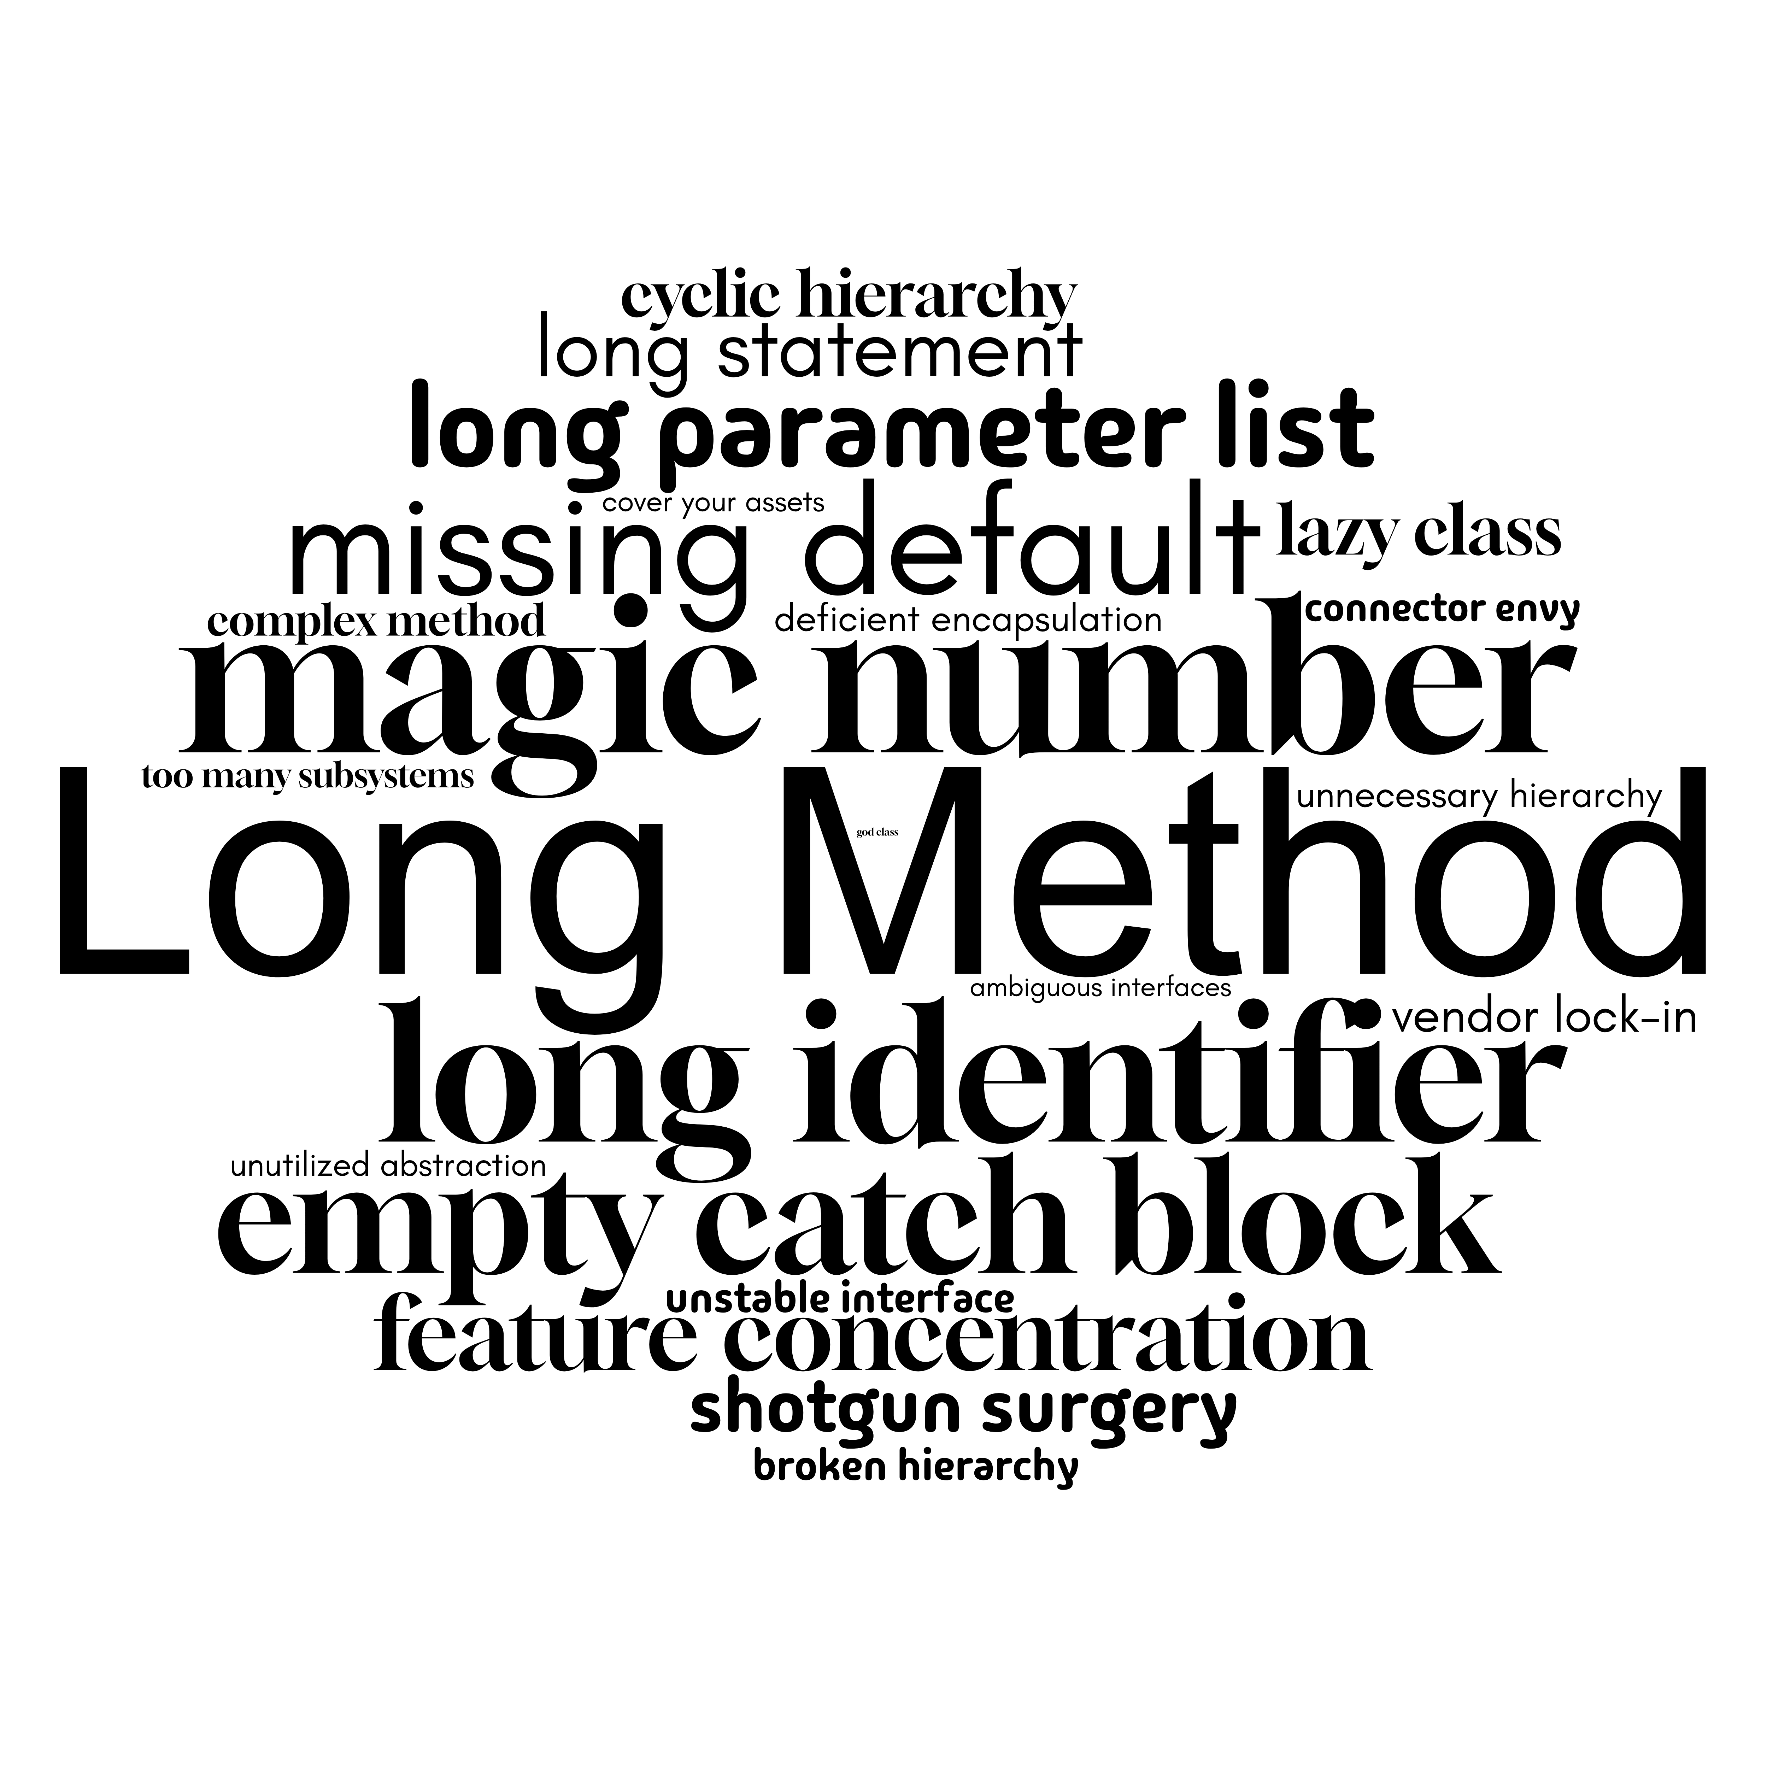
Code smells
Long Method
A code smell is a surface indication that usually corresponds to a deeper problem in the system.
- Martin Fowler
Notes:
Code smells are indicators of deeper problems in the code base. They are not bugs but are violations of code designs that lead to technical debt. (click) There are different kinds of code smells – Implementation (Mnagic Number, Long Para), Design Smells (Broken Hierarchy deficient encap) and arch (connector envy and cover your assets). In this work, we will study about (click) long method smells – a type of implementation smell and how to identify and remove it automatically. – 40s

Slide 5
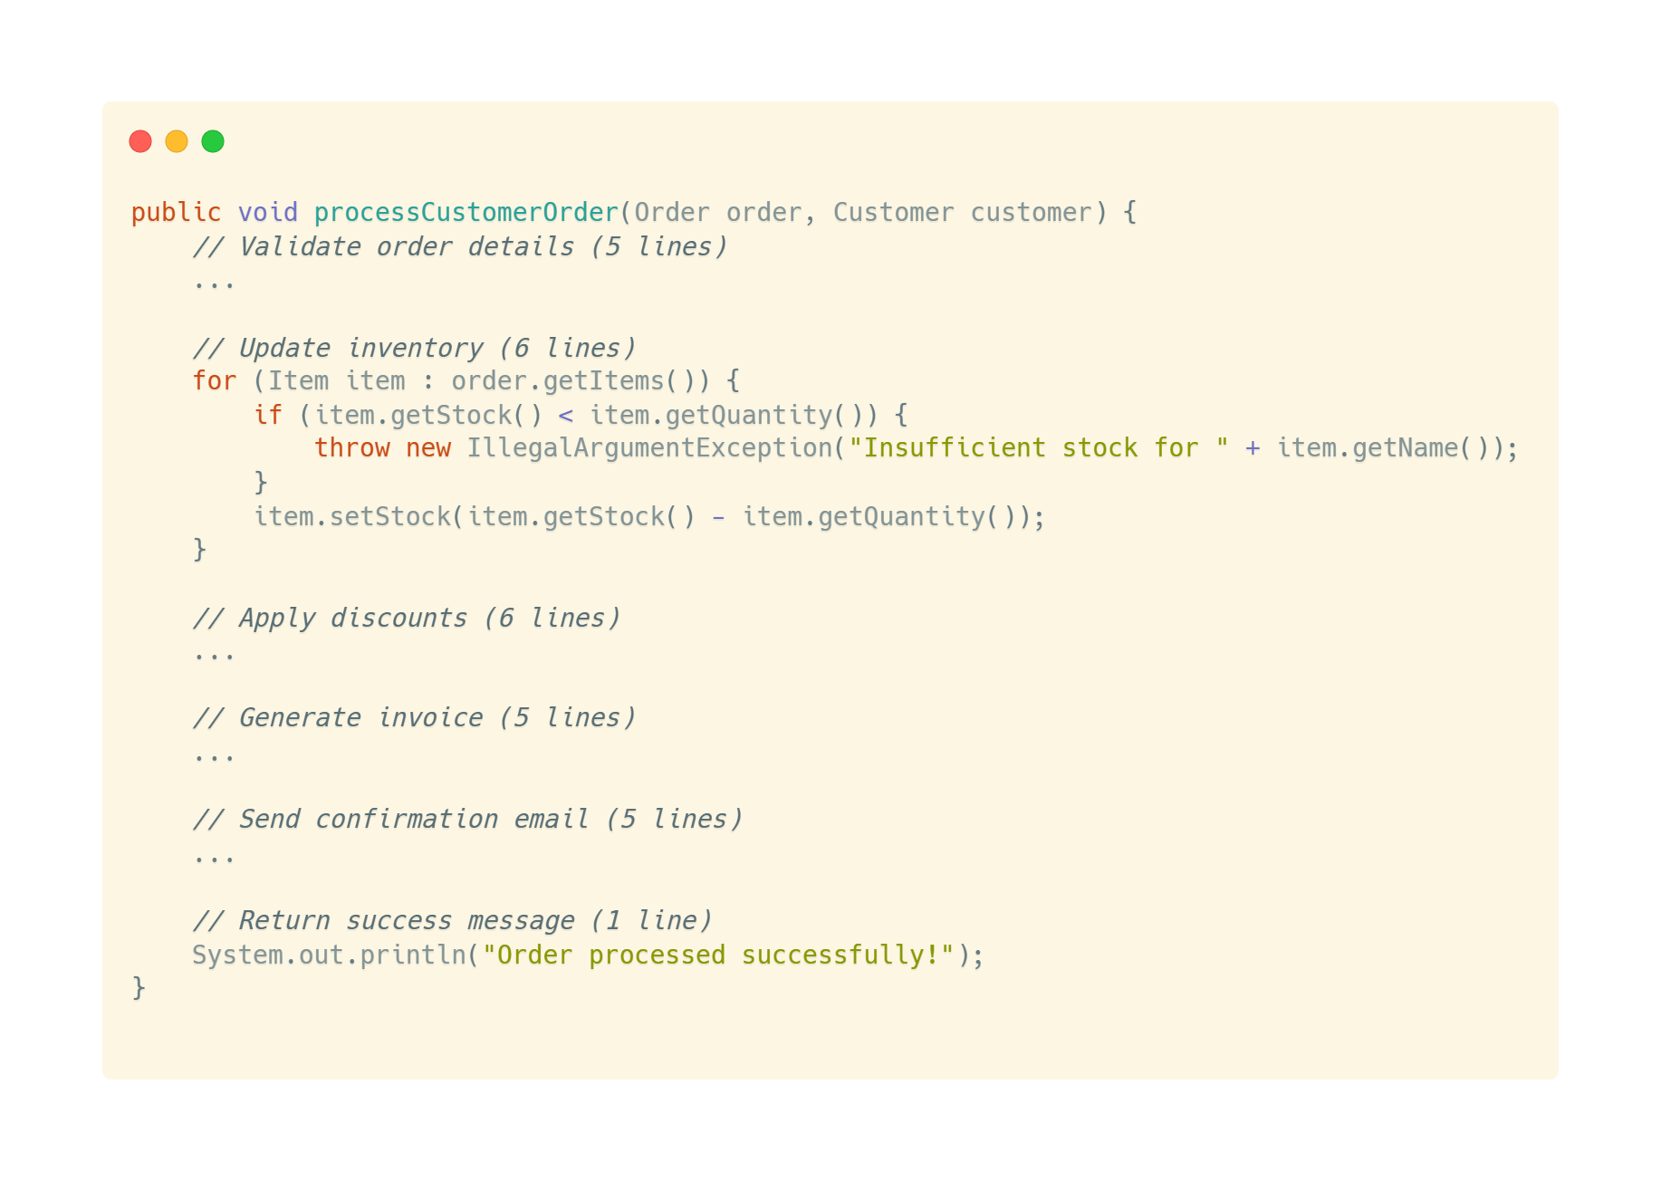
Long method smell
Too many functionalities!
Notes:
Let’s consider the following example. (Click) As we can see the methos is responsible for processing customer orders. A customer order processing pipeline consists of sever independent steps which are being handled by a single method. (Click) Also a general rule of thumb is to have method less than 10 lines. These characteristics make this method a candidate for Long Method Smell. (32s)
What issues are caused by Long Method? Too many func – Point out where

Slide 6
Code refactoring
Move Method
Extract Class
Inline Class
Tsantalis et. al – 49.6%
Refactoring (noun): a change made to the internal structure of software to make it
easier to understand and cheaper to modify without changing its observable behavior.
- Martin Fowler
Inline Method
Extract Method
Extract Variable
Encapsulate Field
Push Down Field
Decompose Conditional
Notes:
Martin Fowler coined the term and defined Refactoring as . In other words, Code refactoring is a transformation applied to source code to remove code smells and improve code maintainability, without changing the functionality. There are various kinds of refactoring (click) such as…Each of these serves a different purpose and removes one or more unique smells. To remove LM Smell, we use Exttract Method refactoring (click) . It is also one of the most prevalent refactorings performed as found in the JDeodrant study. (45s) Don’t read out

Slide 7
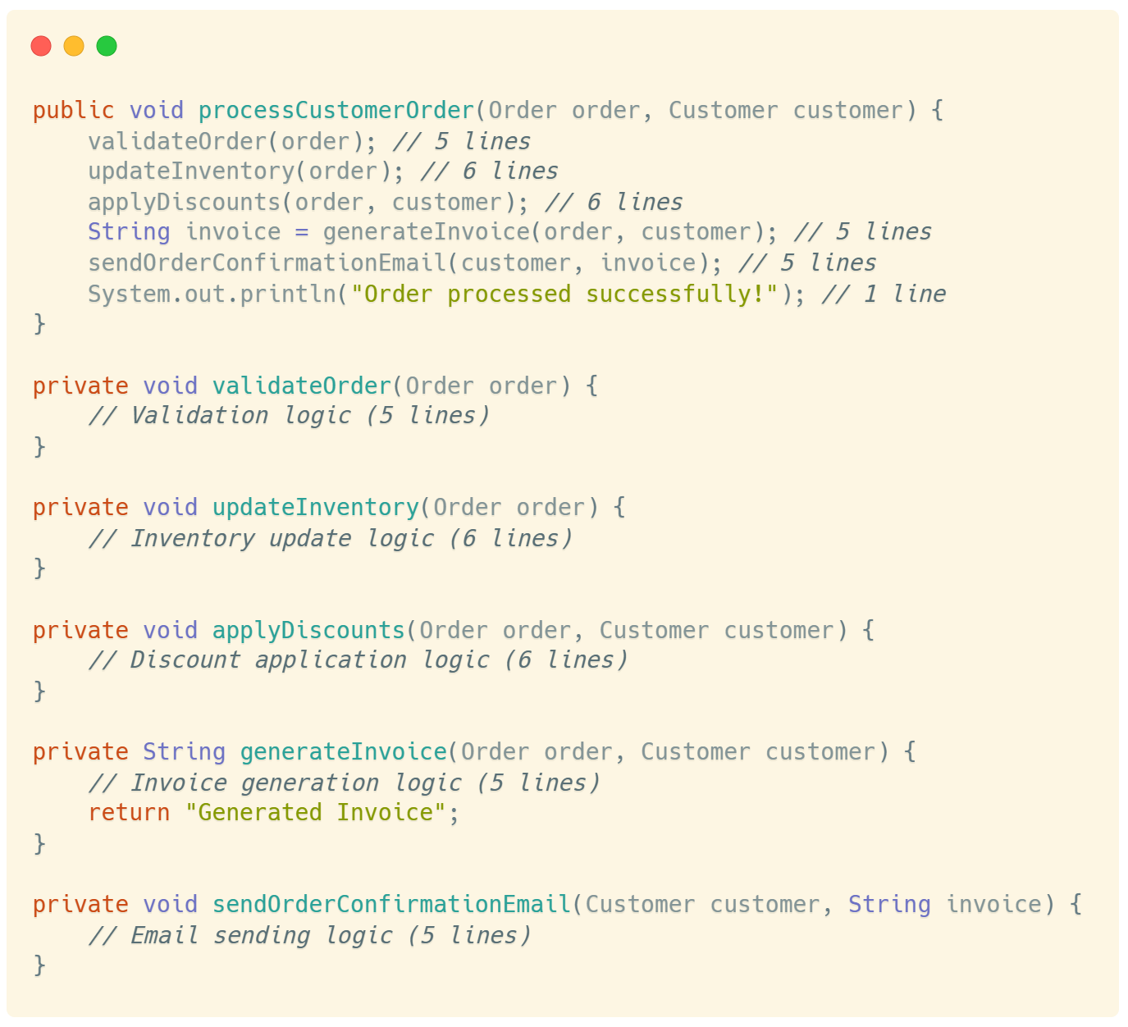
Extract Method refactoring
Notes:
To better understand EM refactoring, let’s consider the previous ex. (click) Here is the method after refactoring. (click) EM ref extracts logic from a long/complex method to individual atomic methods. As we can see here, each of the diff func are extracted out as diff individual methods. For example, the Update Inventory logic was extracted out as a private method and the original method is modified with a call to it (click) (25s)

Slide 8
Limitations
Manual & Semi-automated
Error-prone implementation
Lack of automated tool support
Notes:
However the current state of automatic refactoring operations suffer from few limitations. The first one being (click) the refactorings performed are mostly manual based on developer expertise or semi automated where the developer identifies the refactoring opportunity ad the tool just helps to perform the refactoring. (click) The next limitation is that the automated approaches rely on heuristics or code metrics alone which often leads to error prone identification and implementation. (click) Lastly, there are certain automated tools available like IDE plugins but these tools require the user to identify the exact code block to refactor, i.e. the developer has to mention the start and end statements. The tool only extracts the selected code block. (45s)

Slide 9
Automatic refactoring candidate identification
Part 2
Notes:
We address the previous mentioned limitations in 2 parts. In the first part we aim to automate the identification of methods that actually require extract method refactoring.

Slide 10
limitations
Metric-based automated identification
Static metric-based ML methods
Unsound heuristic-based negative samples
Notes:
There has been efforts from the research community to develop automated solutions. However, these approaches mainly suffer from the following research gap. (click) Metric based automated identification consists of tools which identify refactoring candidates based on pre defined code metric thresholds like LOC, coupling, etc. (click) ML has shown promise to automatically identify hidden patterns in these metrics and classify if a method is a candidate for refactoring. Despite performing better than pre-defined thresholds they fail to understand the hidden contextual and semantic information present in the source code. (click) Lastly, the classification algorithms have no solid way to segregate negative samples (i.e., methods that don’t require refactoring). They mostly rely on unsound heuristics such as LOC or pre defined code metrics.

Slide 11





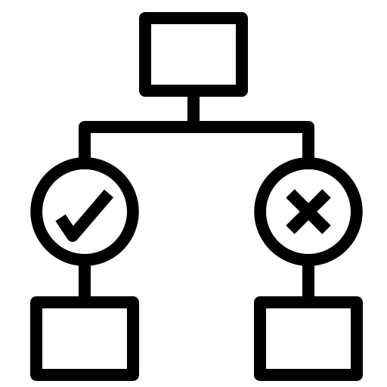
Overview of proposed approach
m₁
GraphCodeBERT
m₂
…
…
RefactoringMiner and PyDriller
m_{n}
Binary classifier
Representation pipeline
Prediction pipeline
Notes:
To addressthese limitations, we propose the following solution to identify extract method refactoring candidate. Our approach consists of 4 major parts. (click) The first part is data collection. We take 5% of the repositories used in one of the previous work by Aniche et. al. RefMiner is a SOTA refactoring detection tool, which identifies which refactoring was performed at which commit. Using this tool and PyDriller, a Git repo parser tool, we construct the positive methods, i.e., methods requiring refactoring and negative methods, i.e. methods not requiring refactoring. (click) The collected data samples are passed through GCB to generate a rich representation of code in the form of embeddings. We performed a pilot study and found that max pooling gave better results than only taking the CLS token representation. (click) The generated embeddings were of size 768. To discard unimportant dimensional values we adopted a self supervised learning method using autoencoders. The model compresses the input to a latent space representation of a smaller dimension and learns to regenerate the input with minimal loss. We utilized the encoder part of the AE model to reduce the dimensionality of our input. (click) Finally using this compressed representation we trained a binary classifier to identify refactoring candidates. (1m45s)

Slide 12
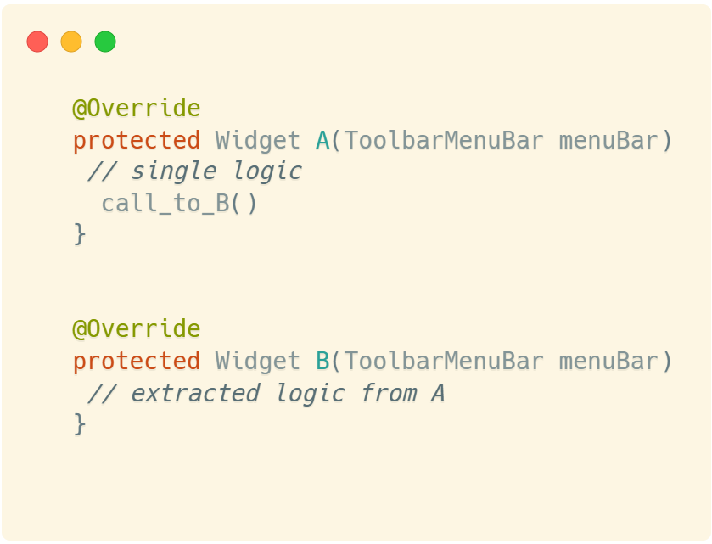
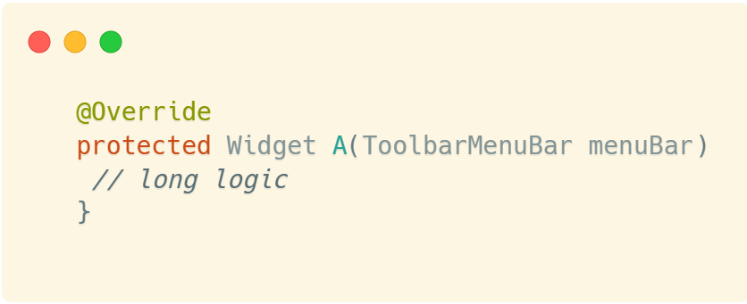
Negative sample identification
Notes:
One major limitation in the existing literature was the grounds on which a method was identified to be not a candidate for refactoring. (click) For example, in a class one method is getting refactored in a single commit, we can’t say that the remaining methods are negative samples. To solve this, We propose a novel approach and define negative samples as the modified original methods after refactoring. For example, if Method A undergoes refactoring forming modified method A and new method B, method B is considered as a negative sample. The idea behind this is that once a method has undergone refactoring, it is highly unlikely to undergo a similar refactoring in the same state.

Slide 13



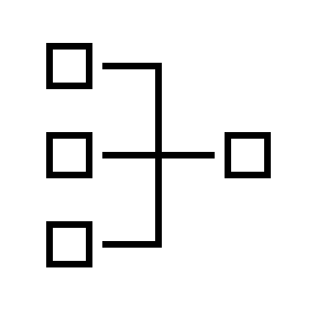



Negative sample identification
Refactoring
Database
RefactoringMiner
Identified
Commits
Clone and parse
repositories
Positive
sample (C_{n-1})
Negative
sample (C_{n})
Notes:
We use this idea to create our dataset. (click) Clone and parse, refminer identifies before and after refactoring commits, using this information we label before refactoring original methods as candidates for ref or pos samples and methods after refactoring as negative samples.

Slide 14
Research questions
RQ 1
How does our proposed approach perform compared to the state-of-the-art?
RQ 2
How effectively does the autoencoder extract features for the classification task?
Notes:
Based on our approach we formulate the following research questions. The first RQ discusses how our approach is compared to the state of the art methods. The second RQ talks about how effective is the AE in feature extraction.

Slide 15
Evaluation metrics
Accuracy
Precision
Recall
F1-Score
Notes:
We use the following evaluation metrics to validate our results. Accuracy: Overall how many were correctly classified Precision: Ratio of correctly predicted positive instances across all predicted positive instances (High precision is lower false positives)
Recall: Correctly predicted positives across all actual positives (high recall means model misses fewer positives) The evaluation was performed on the test split of the dataset. The test split had a distribution of 3:17, reflecting the real-world proportion of positive methods (i.e., methods requiring refactoring) to the total number of methods.

Slide 16
Answering RQ1: SOTA Comparison
GCB – GraphCodeBERT | AE – Autoencoder | NN – Neural Network | RF – Random Forest | Baseline (Work of Aniche et.al.)
Notes:
We considered the sota work by Aniche which trains a RF classifier using code metrics as our baseline. Exp. Results show that our approach performs better than Sota. As we can see, embeddings generated from GCB, when passed through AE and then use the lower dimensionality representation to train a classifier outperforms the SOTA by almost 30% in F1-Score. <Add why superior>

Slide 17
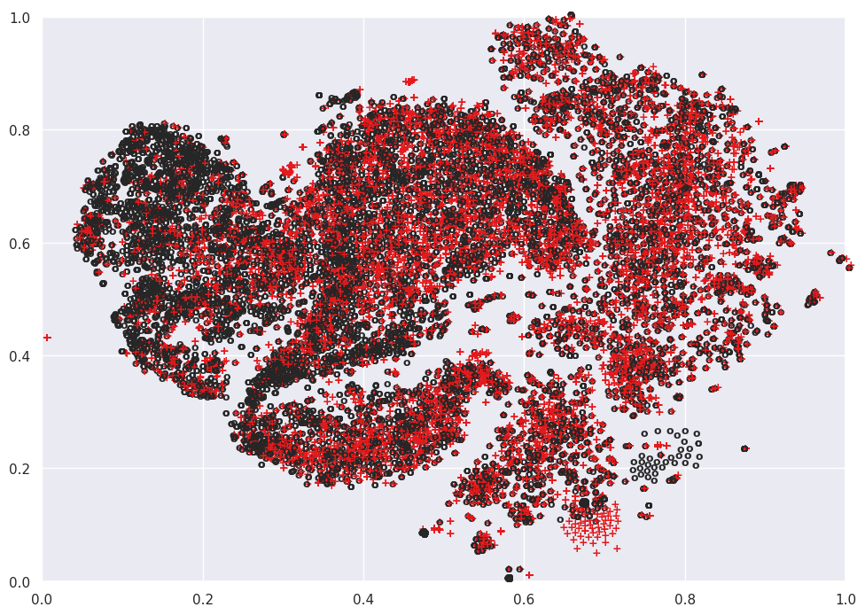
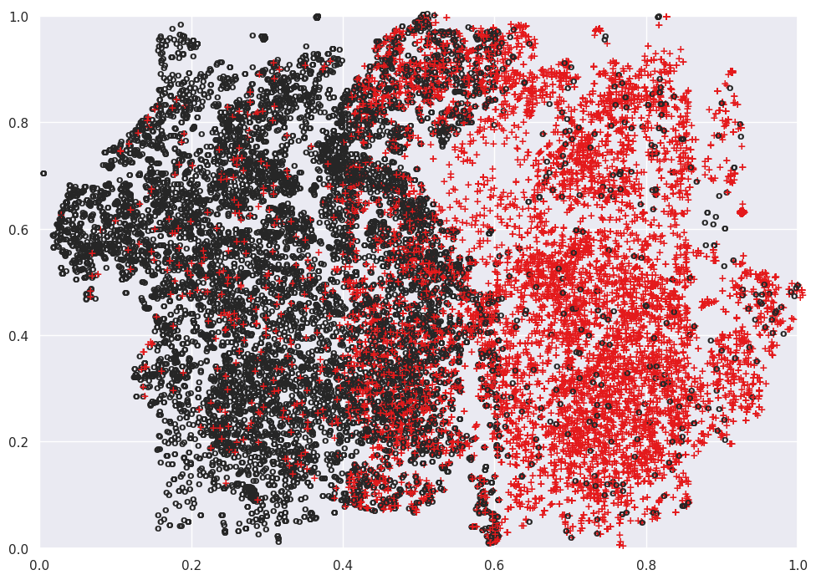
Answering RQ2: feature extraction
Class separation with only embeddings
Class separation with encoded embeddings
Notes:
To evaluate the effectiveness of using AE as feature extractor we analyze the t-SNE plots of embeddings gen. by GCB. On the left, it is the plot of samples with embeddings only and on right it is the one with encoded embeddings. The figure on right shows a reasonably clear bifurcation between the classes with an euclidean distance of 0.367 as compared to 0.122

Slide 18



Key findings
LMs like GraphCodeBERT capture semantic information required for refactoring better
Autoencoders can act as a very good strategy to reduce dimensionality without losing information
Binary classifiers trained on the rich representation of code perform significantly better
Notes:
The key findings from this study are as follows.

Slide 19
Generating refactored code
Part 3
Notes:
In this section, we deal with the second part of automatic refactoring i.e., to automatically generate refactored code.

Slide 20
Limitations
Manual identification of code blocks
Data integrity in online code completion services
Inability to create functionally accurate code
Notes:
We start off by looking at the limitations of the existing studies. The current efforts in this domain have a few limitations. (click) Firstly the automated tools/plugins require the developers to manually identify and select the portion of code that needs to be extracted out, i.e. start and end statements. Such reliance on human knowledge reduces the efficacy and significance of automated refactoring (click) Secondly, the online LLMs like ChatGPT has data integrity issues and require the users to manually refactor the code based on the suggestions. (click) Lastly, all the generative models are either trained for some non-refactoring downstream tasks or a wide range of general purpose tasks. This makes them incapable for generatingcontgext aware functionally accurate refactored code.

Slide 21
Motivation
Manual identification of code blocks
Data integrity in online code completion services
Inability to create functionally accurate code
Notes:
We start off by looking at the limitations of the existing studies. The current efforts in this domain have a few limitations. (click) Firstly the automated tools/plugins require the developers to manually identify and select the portion of code that needs to be extracted out. (click) Secondly, the online LLMs like ChatGPT has data integrity issues and require the users to manually refactor the code based on the suggestions. (click) Lastly, all the generative models are either trained for some non-refactoring downstream tasks or a wide range of general purpose tasks. This makes them incapable for generatingcontgext aware functionally accurate refactored code.

Slide 22

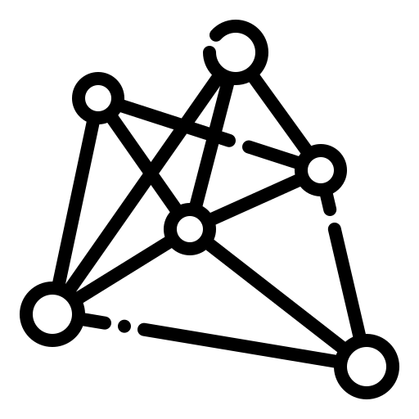




Overview of proposed approach
2
Supervised Model Finetuning
Update model weights
Refactored
Method
L
SFT
Finetuning Dataset
Seq2seq Model
Generated Code
Loss
Refactoring Candidate Method
Create x2 Copies
Code
Repositories
RefactoringMiner
KL Divergence
PPO
1
Dataset Generation
PPO
Finetuning with PPO Dataset
Refactoring Candidate Method
Reference Finetuned Model
Reward Function
Generated Code
Syntax
Compile
Refactoring Detected
Finetuned Model to be Aligned
3
Refactoring Alignment using RL
Policy Update
Notes:
To address the previous mentioned challenges, we propose the following solution. We collect refactoring samples across various open source Java repositories and use this to fine tune a pre-trained seq-seq code language model. Finally, we leverage the Reinforcement Learning algorithm, PPO, to align the fine-tuned model for code refactoring task. Let’s look at the different parts of the architecture next. (click) The first step is to filter out open source projects. We used SEART tool to filter out projects based on GitHub stars and like our previous work, we used RefactoringMiner to sort and curate positive and negative samples. We divided the dataset into 2 halves. (click) The first half is tokenized and used for fine-tuning a pre-trained code language model. (click) To better generate functionally accurate refactored code, we leverage Proximal Policy Optimization, a popular actor-critic framework to align the model. This alignment process involves several key components: the actor (the LLM itself), the critic (evaluates the quality of the refactoring), rewards (numeric score that provide feedback on their quality.) , the value function (estimates the expected reward), and KL divergence (measures diff between old policy and new one. It ensures that changes remainwithin reasonable limits). (1m 40s)

Slide 23
Overview of reward function
Generated code
Error nodes in AST?
Compiles?
Refactoring detected?
R_{syntax} = 1 or -1
R_{compile} = 1 or 0
R_{detect} = 1 or -1
Notes:
The PPO algorithm optimizes the model behaviour based on the static non differentiable rewards generated by the critic. (click) In our study, the reward function consist of 3 stages. In the first stage, we create AST using Tree-Sitter. If there are error nodes, it signifies the generated code is syntactically incorrect. Second stage is to compile the code. If the compiled binary is being created we assign a positive integer of unit value for the reward. And lastly, using the code diff and RefactoringMiner tool, we try to verify if the code generated is refactored. Finally we calculate the sum of all these rewards and the PPO algorithm optimizes the policy based on it.

Slide 24
Research questions
RQ 1
Performance of supervised fine-tuning for refactoring
RQ 2
Effectiveness of reinforcement learning for automated refactoring
RQ 3
Evaluating the performance of reinforcement learning and fine-tuned LLMs for refactoring
Notes:
We have formulated 3 research questions based on our proposed approach. (click) measures the perf… (click) signifies the effectiveness…, (click) evaluates…

Slide 25
Research questions
RQ 1
RQ 2
RQ 3
Performance of supervised fine-tuning for refactoring
Effectiveness of reinforcement learning for automated refactoring
Evaluating the performance of reinforcement learning and fine-tuned LLMs for refactoring
Notes:
We have formulated 3 research questions based on our proposed approach. (click) measures the perf… (click) signifies the effectiveness…, (click) evaluates…

Slide 26
Evaluation metrics
Quantitative
Qualitative
BLEU
ROUGE
CodeBLEU
Syntactic correctness
Compilation success
Refactoring detected
# of unit tests passed
Notes:
To evaluate the performance of our approach, we use 2 kinds of metrics – Quantitative and Qualitative. (click) We use 3 kinds of quant metrics viz., BLEU, ROUGE, and CodeBLEU. BLEU and ROUGE are popular metrics to evaluate machine generated text against a ground truth. CodeBLEU is an extension of BLEU but for code generation. (click) We use syn, compilation success, ref detected and # ut passed as metrics for evaluating the quality and functional correctness of the generated code. (38s)

Slide 27
Answering rq1: performance of sft for refactoring
Notes:
In RQ1, we study the performance of supervised fine-tuning of a pre-trained language model for refactored code generation. Quantitatively speaking, we find that PLBART performs better than both the decoder-only models and slightly better than Code-T5 <Read about the pre training objkectives of the models>

Slide 28
Answering rq1: performance of sft for refactoring
Notes:
However, qualitatively assessing the models reveals that code-T5 performs better than PLBART across all metrics. This finding supports our hypothesis that code generated by fine tuned models may not always produce functionally accurate refactored code.

Slide 29
Answering rq2: Effectiveness of RL for automated refactoring
Notes:
To study the effectiveness of reinforcement learning we directly apply PPO on the pretrained code language models. As expected, the performance was sub-par both quantitatively and qualitatively. This shows the fact that supervised fine tuning performs better at generating refactored code than fine tuning a model using RL algorithms. - SFT has stable gradient updates based on direct supervision (RL might unlearn useful patterns due to reward optimization) - SFT preserves the base LLM's knowledge and capabilities - SFT learns from direct examples efficiently (RL requires many iterations to learn basic patterns) So SFT can act as a starting point for RL

Slide 30
Answering rq3: performance of sft + rL for refactoring
Notes:
Finally, we validate our proposed novel approach of aligning a supervised fine-tuned model using reinforcement learning. As we see from the experimental results, using this approach code-t5 performs better than PLBART in terms of quantitative metrics . Precisely, this approach led to CodeBLEU score increase of 16.45% when compared to SFT model performance. This performance gain can be attributed to SFT learning the basic and RL optimizing it to generate functionally accurate code.

Slide 31
Answering rq3: performance of sft + rL for refactoring
Syntactic correctness
Refactoring detected
Compile successfully
# of unit tests passed
Notes:
When we evaluated the quality of the generated refactored code, the results were even more impressive. (click) We see an increase of 4% in terms of syntactic correctness, (click) (click) 6% increase in terms of refactoring detected and (click) 28% increase in number of test cases passes. This shows that our proposed approach is effective in functionally accurately performing extract method refactoring.

Slide 32
Answering rq3: performance of sft + rL for refactoring
Notes:
When we evaluated the quality of the generated refactored code, the results were even more impressive. (click) We see an increase of 4% in terms of syntactic correctness, (click) (click) 6% increase in terms of refactoring detected and (click) 61% [66 -41] increase in the number of test cases passed. This shows that our proposed approach is effective in functionally accurately performing extract method refactoring.

Slide 33
Key findings
Relying solely on quantitative metrics may yield misleading results and potentially produce low-quality refactored code.
Generating refactored code from a pre-trained model directly aligned with RL does not produce comparable results.
Combining SFT and RL objectives yields superior results in generating refactored code.
Notes:
Now summarize the key findings from the second part of this thesis.

Slide 34
Conclusion and Q&A
Part 4
Notes:
In this final part, I will summarize this thesis and open the floor for questions.

Slide 35
Conclusion
Refactoring Candidate Identification
Static metric based manual identification
Metric based ML solutions
Refactoring Generation
Manual selection of code blocks
Functionally inaccurate code generation
Proposed solution of self supervised learning beats SOTA by 30%
Aligning models with RL improved performance both quantitively and qualitatively
Notes:
In this thesis we tried to fully automate extract method refactoring. (click) We first looked at the challenges in refactoring candidate identification. <challenges> (click) (click) and proposed a solution (click) with GCB AE and Binary classifier to solve it. Next, we looked at (click) Refactoring generation. The challenges in existing work included (click) (click) To address these challenges we proposed a novel solution with SFT + RL.

Slide 36


Thank You
SMART Lab
Software Maintenance and Analytics Research Team
indranil.palit@dal.ca

